Slide 1
Banking Application

Slide 2
AGENDA
Introduction​
Features
​Summary​

Slide 3
Introduction
It is a single page web application to provide a full view about the services of what it can do and what are all the features available without navigating to another page.

Slide 4
PRIMARY Features
Accounts
Payments
Expenses portfolio
Transaction History

Slide 5
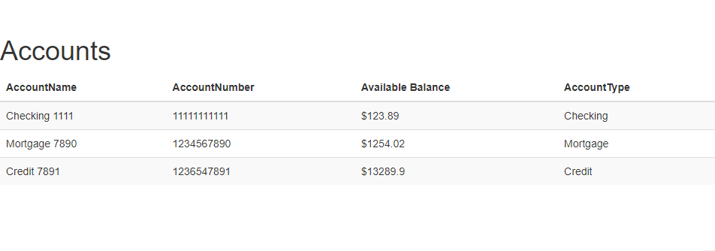
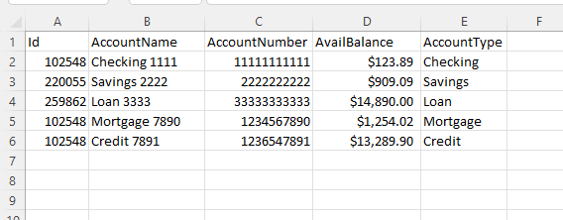
Accounts
UserId:102548
View
Data

Slide 6
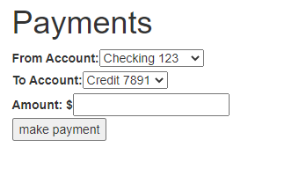
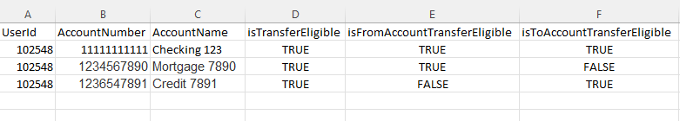
Payments
Data Model
Based on the Account Transfer Eligibility From and To Account DropDown are filled.

Slide 7
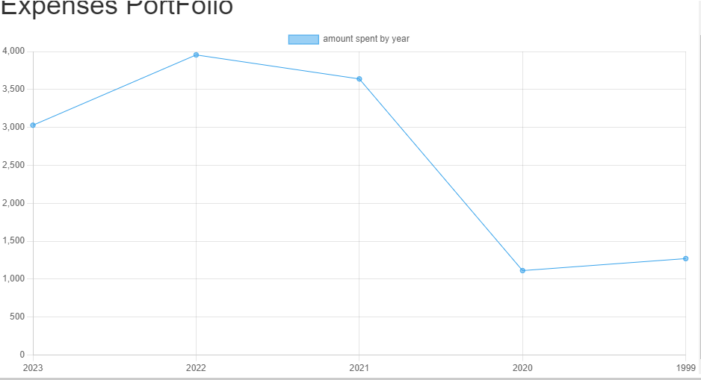
Expenses Portfolio
Customer can compare Their Yearly Expenses

Slide 8
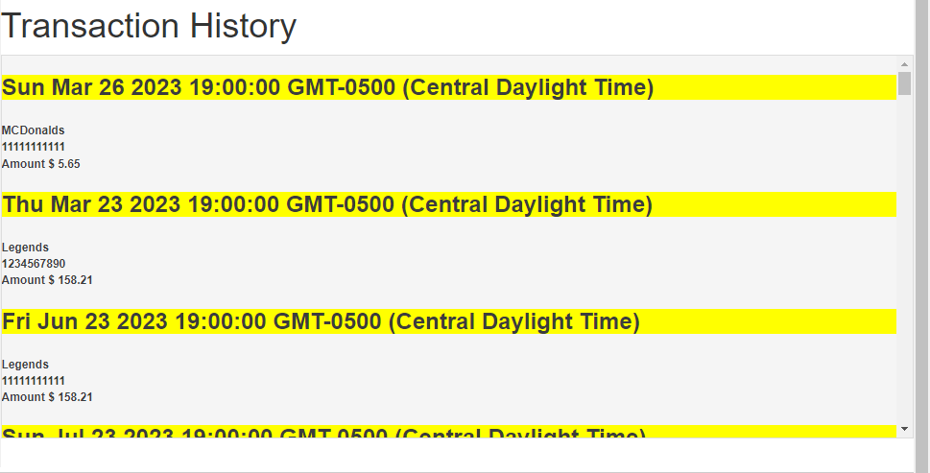
Transaction history
All Transactions are sorted and grouped by transaction Date

Slide 9
SUMMARY
The project aims to develop a single-page banking application for both business and consumer customers. It includes features like accounts, transfers and transaction history, graph/chart analysis of expenses, investments specific to the customer. The data will be stored in excel sheets, and later a database layer can be attached.

Slide 10
THANK YOU
Srikanth Munaga 700742680
Vikram Dingari 700742014

